Slide 1
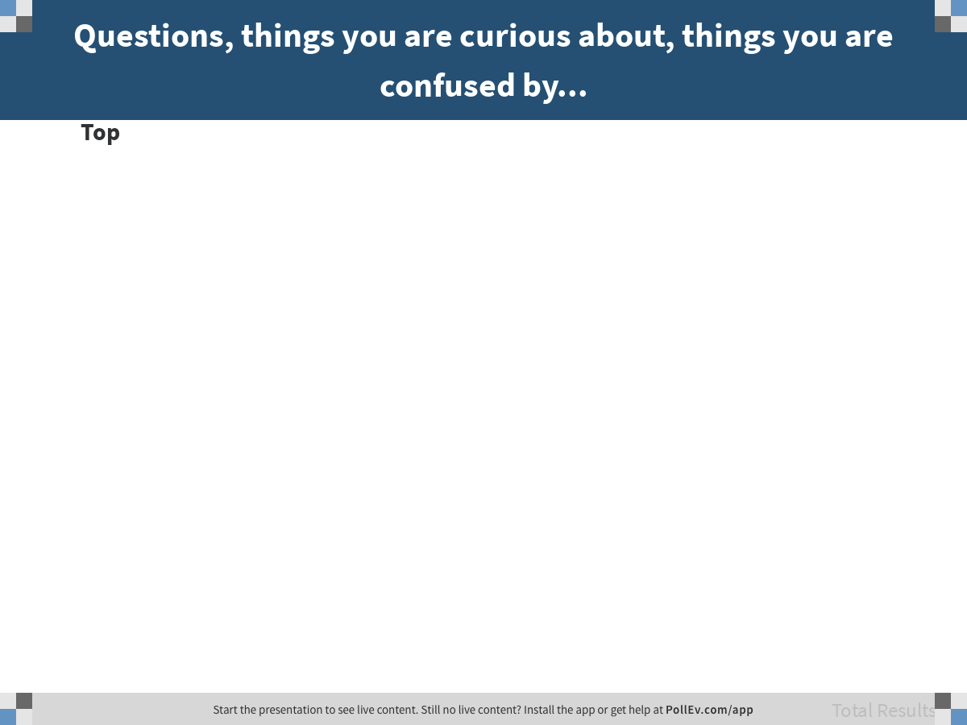
Notes:
Questions, things you are curious about, things you are confused by...
https://www.polleverywhere.com/discourses/U3xXdwryu6zGpGt0ww0Rv

Slide 2
Statistical Models
(continued)

Slide 3
The sample and the DGP

Slide 4

Describe as fully as possible the relationship between a Sample Distribution and the DGP.
DGP
Population
Sampling
Distribution
Statistical Model
Data / Sample
“The DGP is how experimenters gather their samples and data points.”
What’s wrong with this answer?

Slide 5
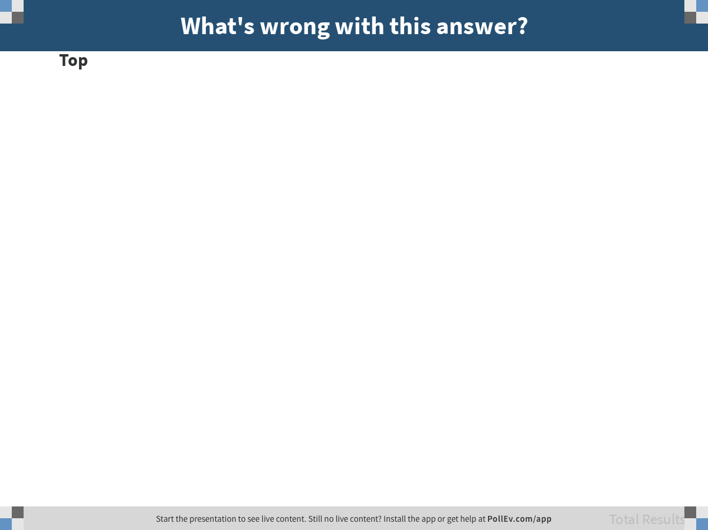
Notes:
What's wrong with this answer?
https://www.polleverywhere.com/discourses/GNj5m9JwR9w2K2RIW0JqA

Slide 6
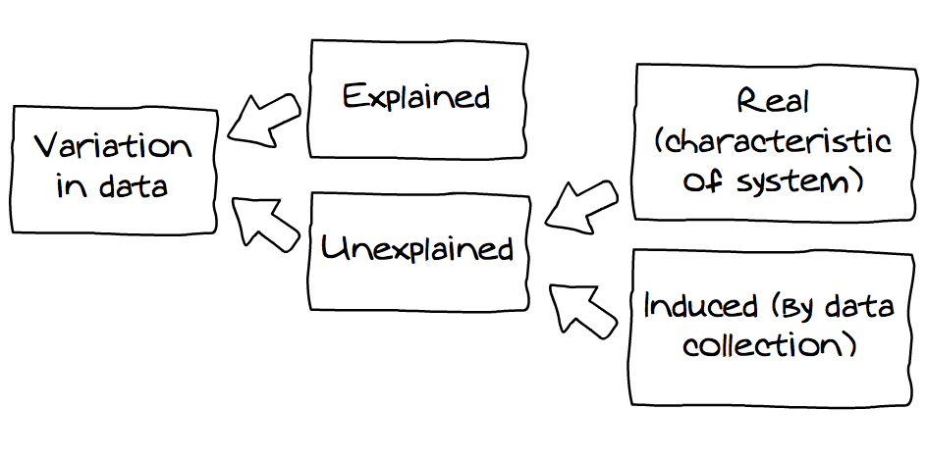
Where is the DGP in this picture?
measured
unmeasured

Slide 7
Where is the DGP in this picture?
measured
unmeasured

Slide 8
Describe as fully as possible the relationship between a Sample Distribution and the DGP.
DGP
Population
Sampling
Distribution
Statistical Model
Data / Sample
“A sample distribution contributes to the data generating process.”
What’s wrong with this answer?

Slide 9

Notes:
What's wrong with this answer?
https://www.polleverywhere.com/discourses/mcBHwDRXuzBaNWyqKxQsA

Slide 10
Some Good Answers
“Sample distribution is present within a data set and can be explained by DGP (data generating process). A data set (sample) is taken from a population and there will be variation present. We as psychologists will try to understand HOW this variation transpired in order to make sense of the real world variation.”
“The DGP is the process that produces variation in the real world, that then produces variation in our data. Sample distributions are a visual way to understand and interpret the DGP for a particular variable.”
“The relationship between a Sample Distribution and the DGP is that by looking at the sample distribution, we can make assumptions about the processes that generated that data and further analyze the accuracy of those assumptions.”

Slide 11
Statistical Models
(continued)

Slide 12
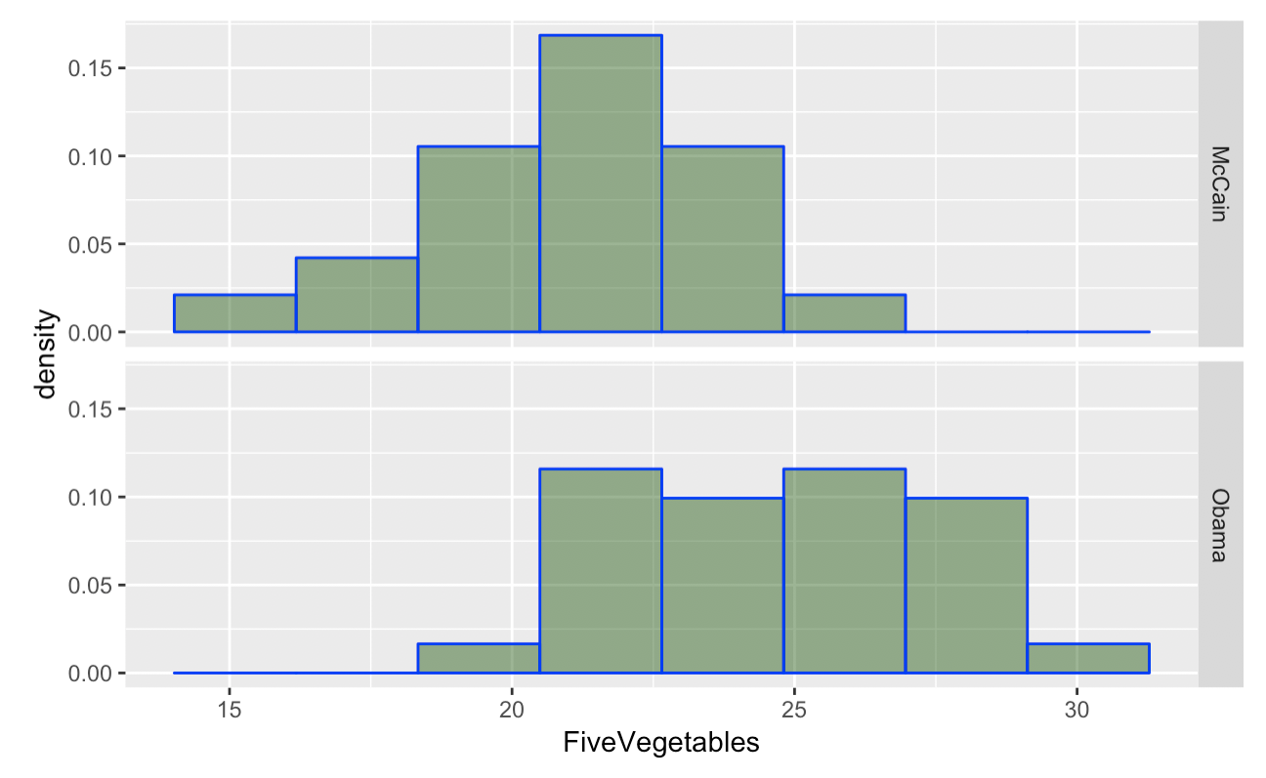
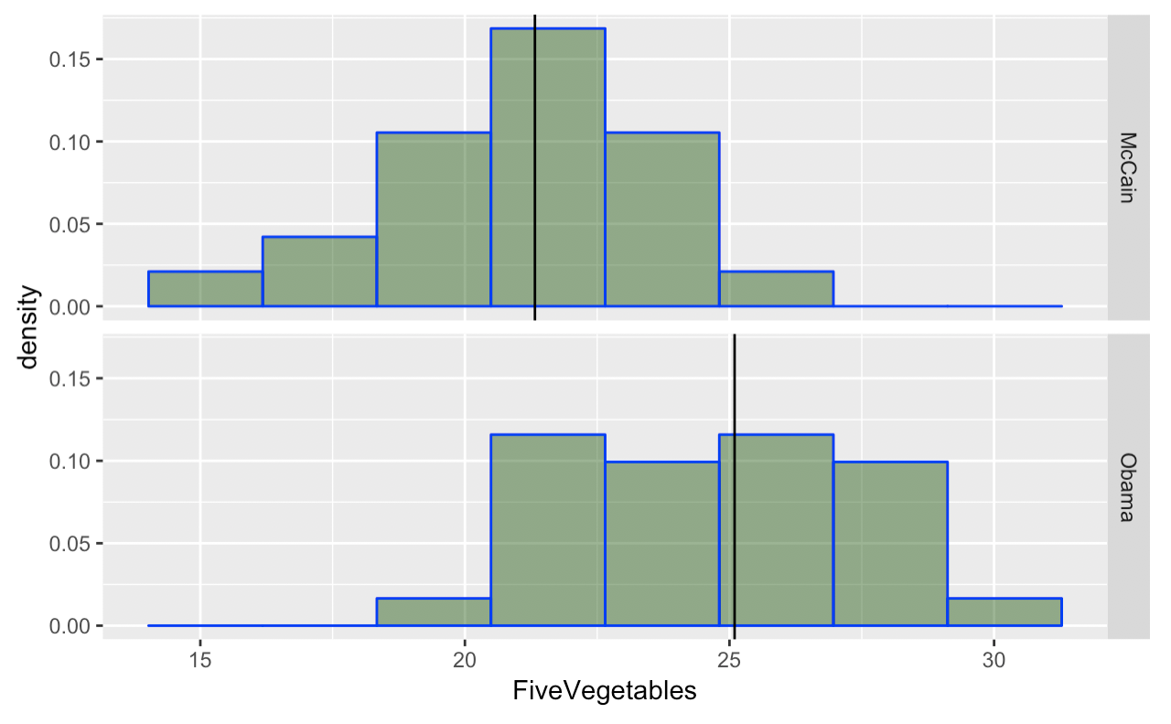
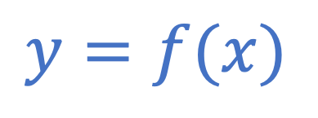
What is a Statistical Model?
M=21.3
M=25.0
FiveVegetables = Pres2008 + Other Stuff
A mathematical function used to generate a prediction
How does this improve on our previous definition of explain?
$$y=f(x)$$

Slide 13
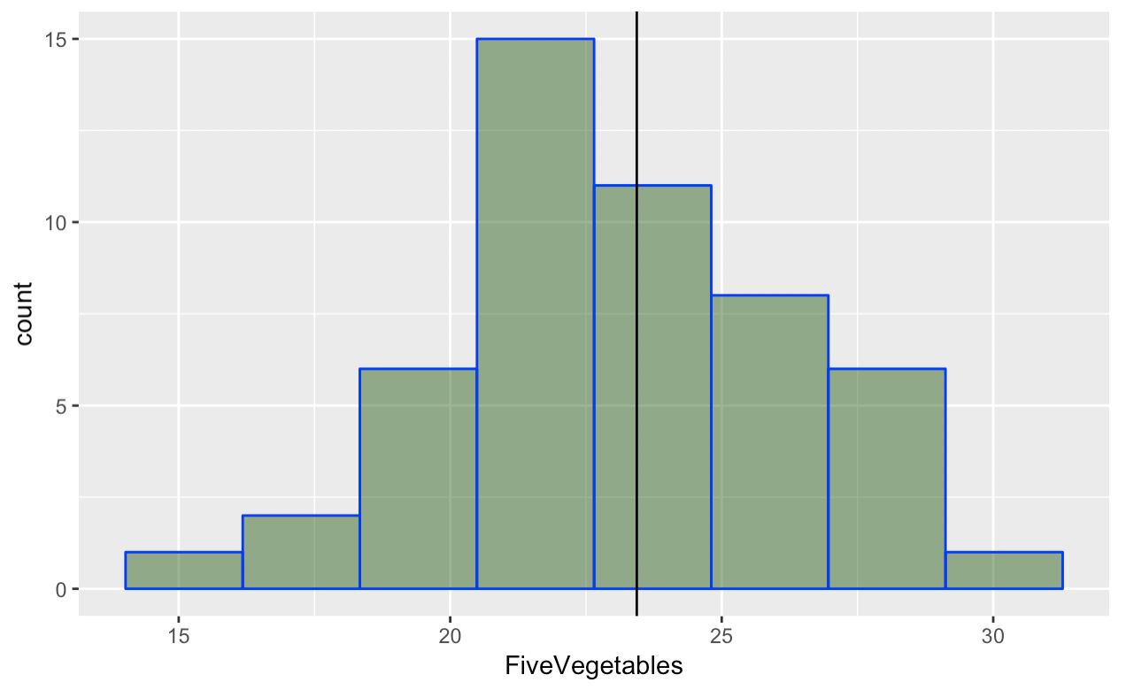
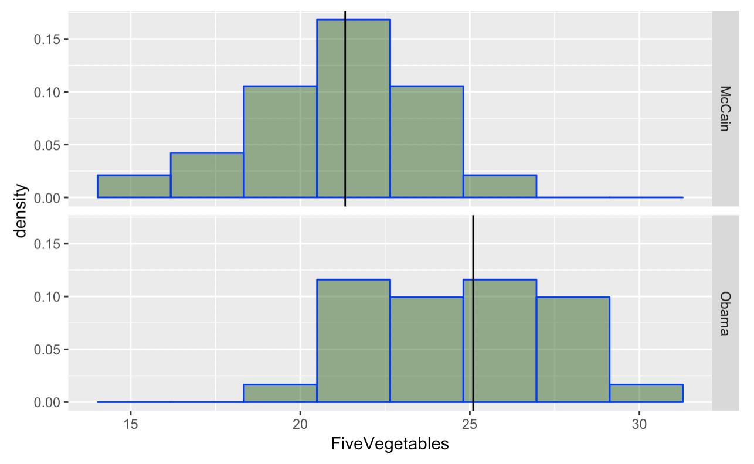
Comparing models
M=23.4
M=21.3
M=25.0
FiveVegetables = mean + other stuff
FiveVegetables = Pres2008 + other stuff
Why do we need the empty model?

Slide 14
Comparing models
FiveVegetables =
mean + other stuff
M=23.4
If you use mean as prediction, which model has less error? (gesture)
M=21.3
reduce error = explain variation
M=25.0
FiveVegetables =
Pres2008 + other stuff

Slide 15
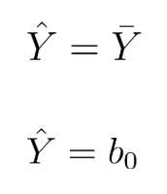
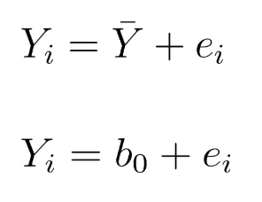
Notation for the Empty Model
FiveVegetables = mean + other stuff
model
data=model + error
Can be used for any one-parameter model

Slide 16

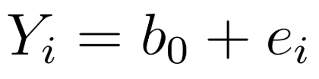
DGP
Population
Sampling
Distribution
Statistical Model
Parameters and Statistics
Data / Sample
Notes:
Can’t know exactly the DGP (statistics, only better than nothing)… but we have seen how a random DGP might far… what kind of samples could have been generated from such a process…

Slide 17

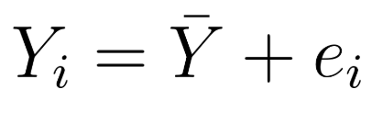
DGP
Population
Sampling
Distribution
Statistical Model
General versus Specific
Data / Sample
Notes:
Can’t know exactly the DGP (statistics, only better than nothing)… but we have seen how a random DGP might far… what kind of samples could have been generated from such a process…

Slide 18
Key points about models
Statistical models constructed from data, but used to model the DGP
Models serve two key functions:
Help us understand DGP
Let us make predictions about future observations
DGP
Population
Sampling
Distribution
Statistical Model
Data / Sample

Slide 19
DATA = MODEL + ERROR

Slide 20
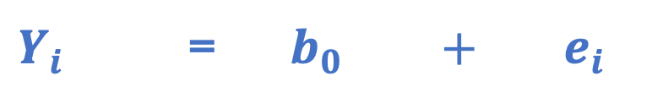
DATA = MODEL + ERROR
Mean = 23
(our simplest
model)
Alabama = 20
Model
Prediction
Also called residual
Alabama 20
Mean 23
Error
-3
=
+
$Y_{i}$ = $b_{0} + e_{i}$
Every data point can be partitioned into model + error.

Slide 21
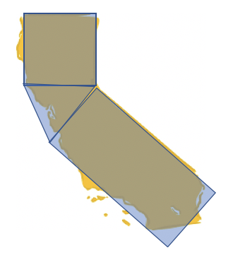
Fitting the Empty Model
What does it mean to “fit” a model?
Use lm() to fit the empty model for FiveVegetables

Slide 22
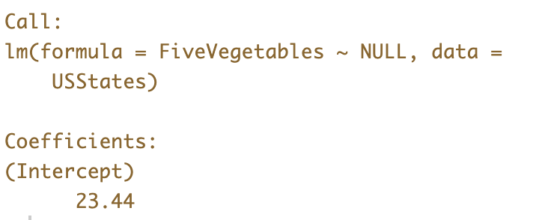
Fitting the Empty Model
What does it mean to “fit” a model?
Use lm() to fit the empty model for FiveVegetables
What is the 23.44?

Slide 23
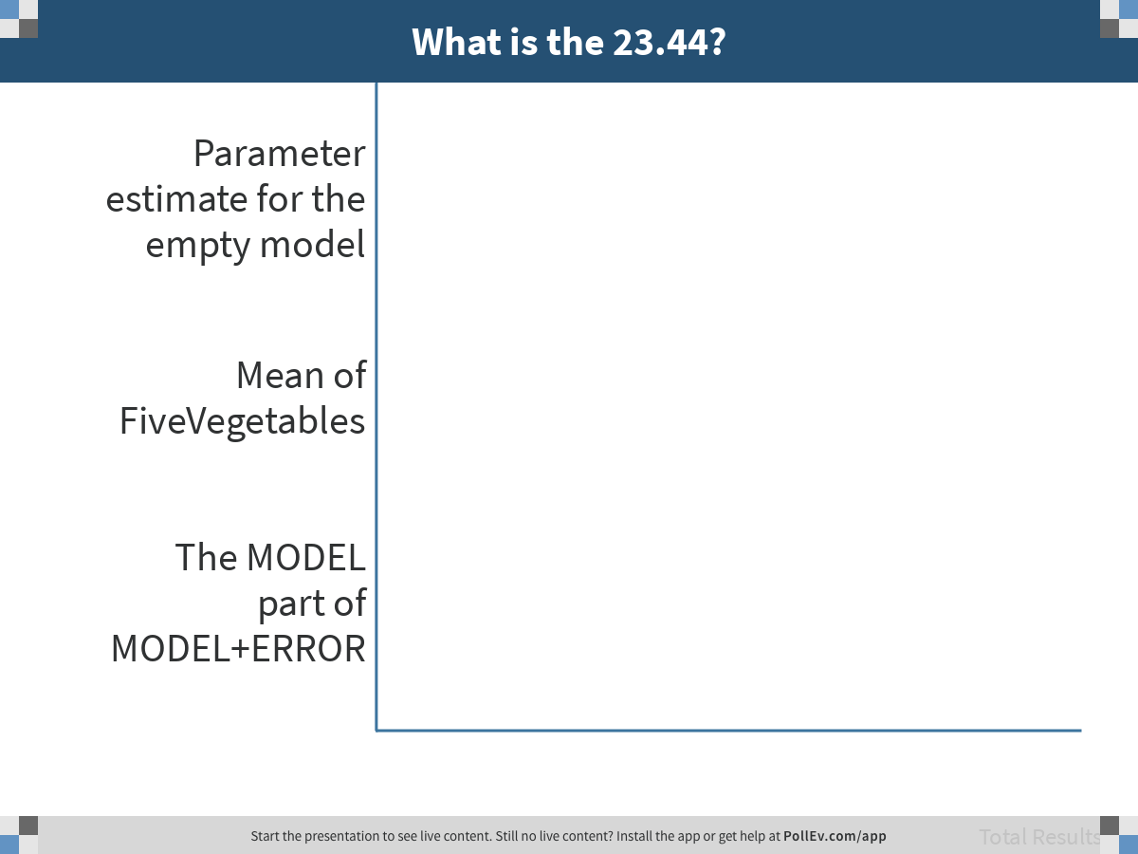
Notes:
What is the 23.44?
https://www.polleverywhere.com/multiple_choice_polls/GGKo4vcwwEojXlhgtMGFH

Slide 24
Fitting the Empty Model
What does it mean to “fit” a model?
Use lm() to fit the empty model for FiveVegetables
What is the 23.44 in GLM notation?

Slide 25
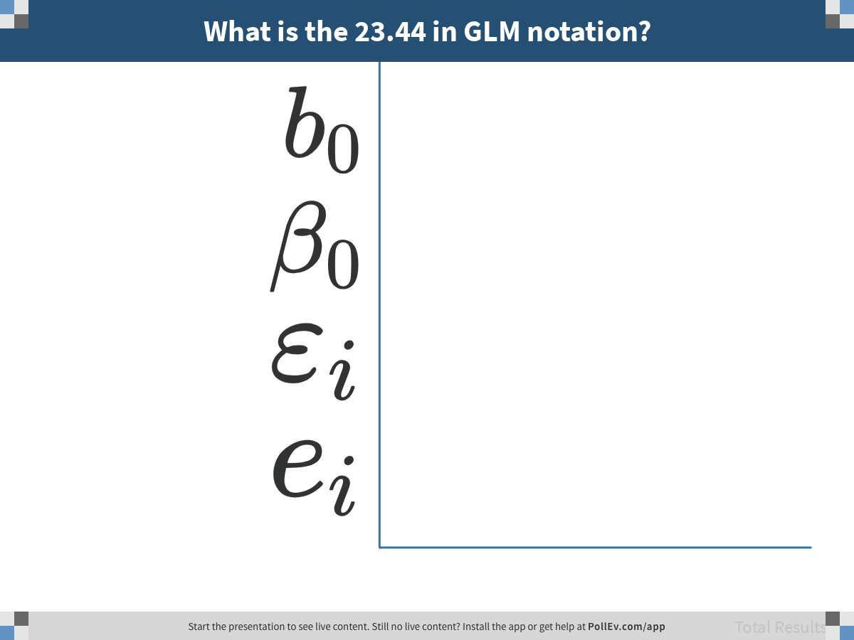
Notes:
What is the 23.44 in GLM notation?
https://www.polleverywhere.com/multiple_choice_polls/DYvDghx3y3sH5oDvbdzB8

Slide 26
Generating Model Predictions
Can you think of another way to fit the empty model?
Use the predict() function to generate model predictions for the empty model of FiveVegetables
Save the predictions in a new variable in the USStates data frame called empty.predict
Look at the data frame to see if your new variable is there

Slide 27
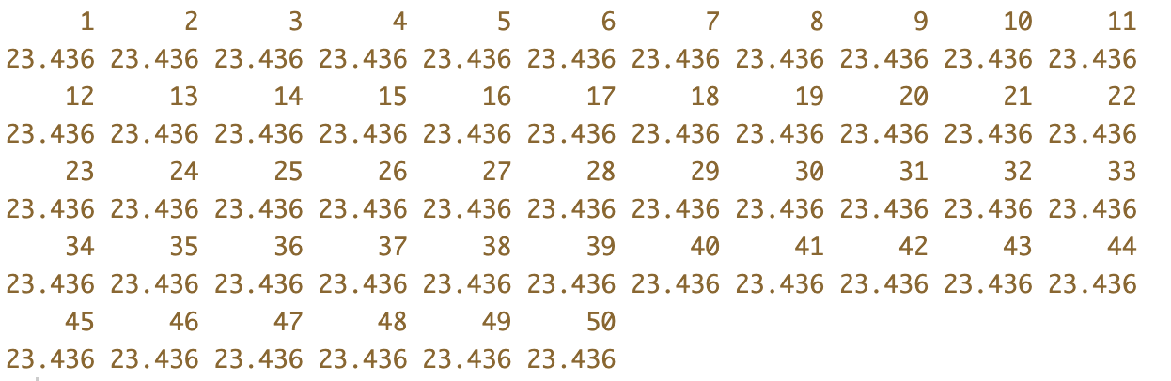
Generating Model Predictions
What R code produced this output?

Slide 28
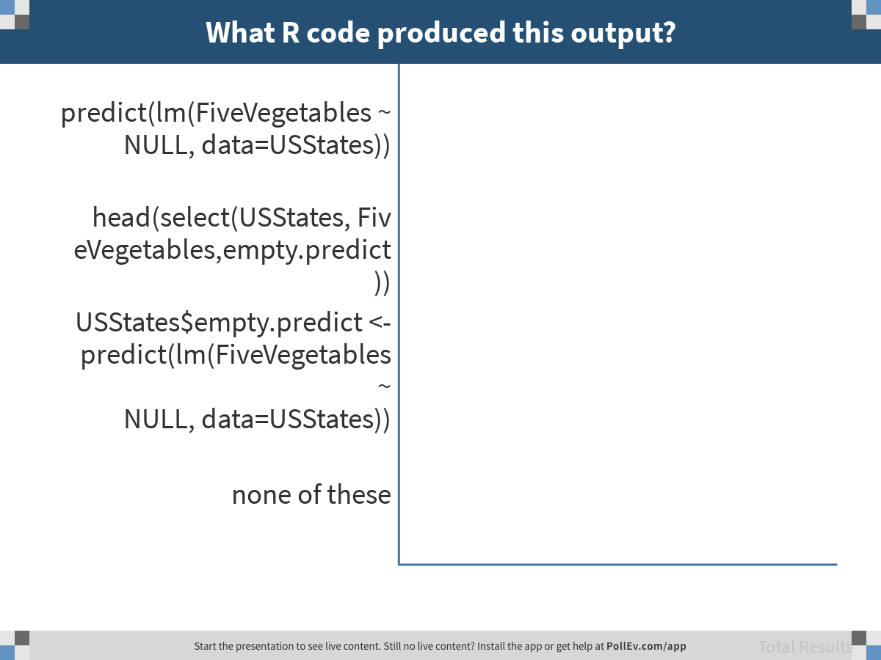
Notes:
What R code produced this output?
https://www.polleverywhere.com/multiple_choice_polls/LdMDWaQHo72V303JAKOrr

Slide 29
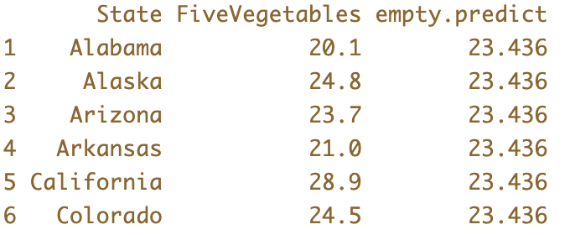
Generating Model Predictions
What R code produced this output?

Slide 30
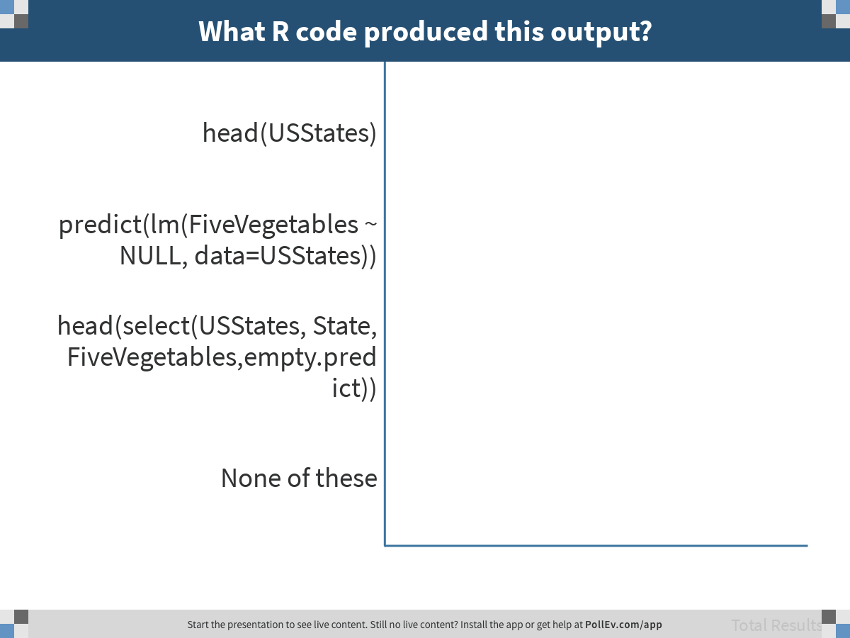
Notes:
What R code produced this output?
https://www.polleverywhere.com/multiple_choice_polls/xAQHKur4RLeEzionR7ze7

Slide 31
Generating Model Predictions
Why does every state have the same value for empty.predict?

Slide 32
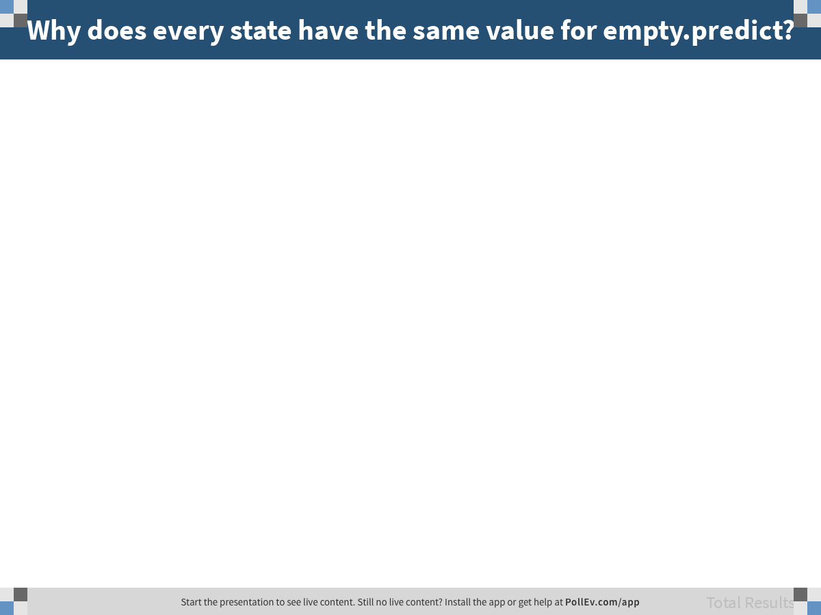
Notes:
Why does every state have the same value for empty.predict?
https://www.polleverywhere.com/free_text_polls/RHB98xoTOGQoOocz7r8FB

Slide 33
Generating Residuals
Use the resid() function to get the residual for each state from the empty model for FiveVegetables
Save it in a new variable called empty.resid
Do a head(select() to show the first 6 rows of State, FiveVegetables, empty.predict, and empty.resid

Slide 34
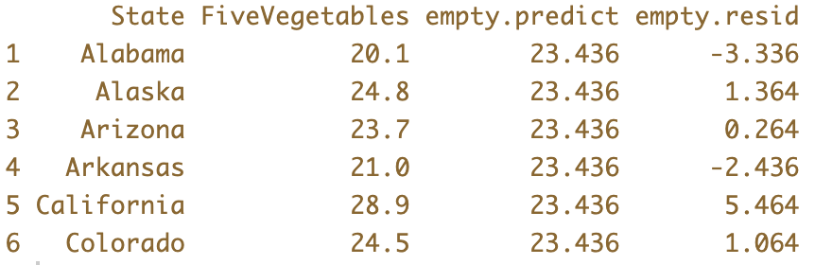
Generating Residuals
Why are some of the values negative and some positive in the empty.resid column?

Slide 35
Generating Residuals
What GLM notation would you use to represent each of these residuals?

Slide 36
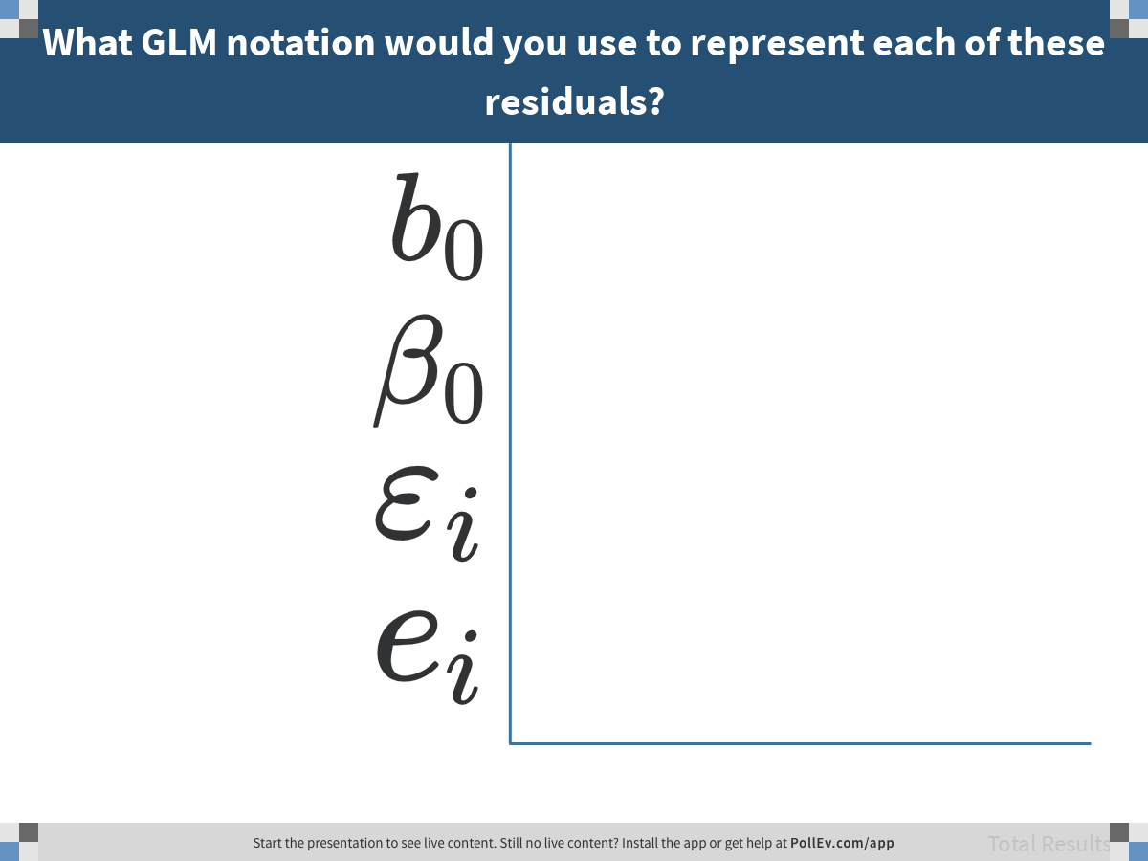
Notes:
What GLM notation would you use to represent each of these residuals?
https://www.polleverywhere.com/multiple_choice_polls/Q22xWanZqGrO5oL9KA8Pa

Slide 37
Discuss with a neighbor
Where in this printout is DATA, MODEL, and ERROR?

Slide 38
Graphing Residuals
Imagine you make two histograms: one of FiveVegetables, and the other of empty.resid. How will they compare? (in your head, please!)

Slide 39
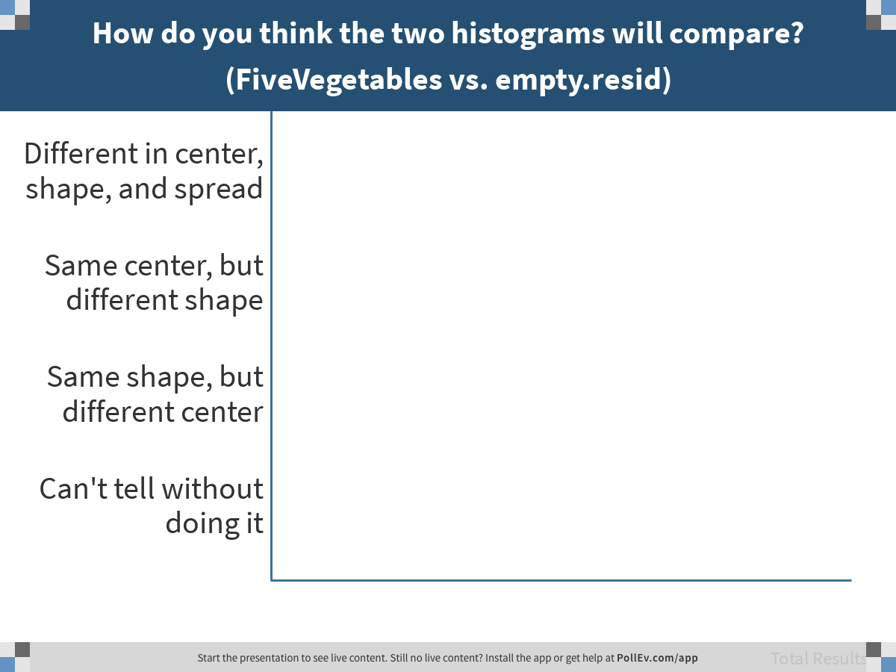
Notes:
How do you think the two histograms will compare? (FiveVegetables vs. empty.resid)
https://www.polleverywhere.com/multiple_choice_polls/LTRj4yzvwKM9PUGF8bfLj

Slide 40
Graphing Residuals
Go ahead and make the two histograms, one for FiveVegetables and the other for empty.resid

Slide 41
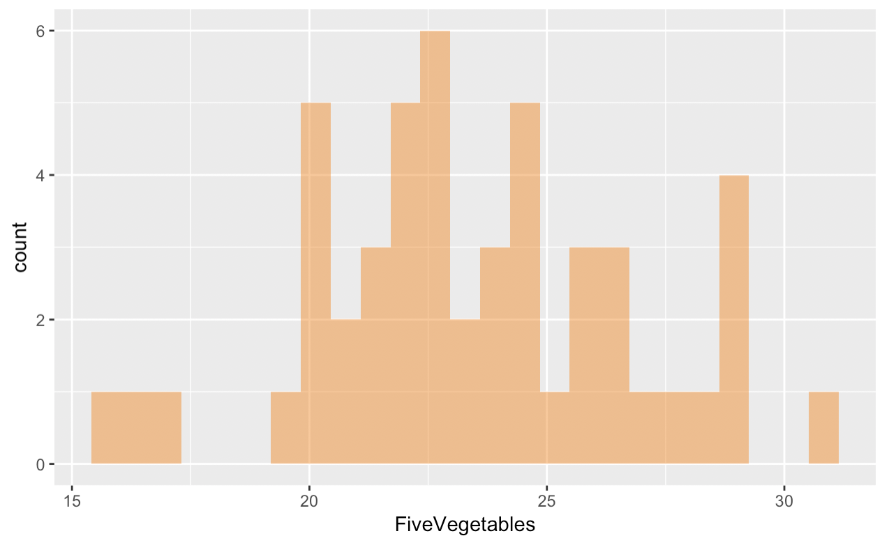
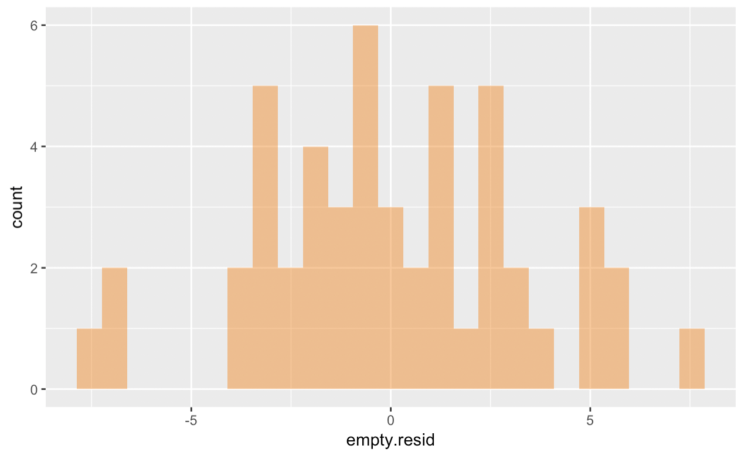
Graphing Residuals
Compare these two histograms

Slide 42
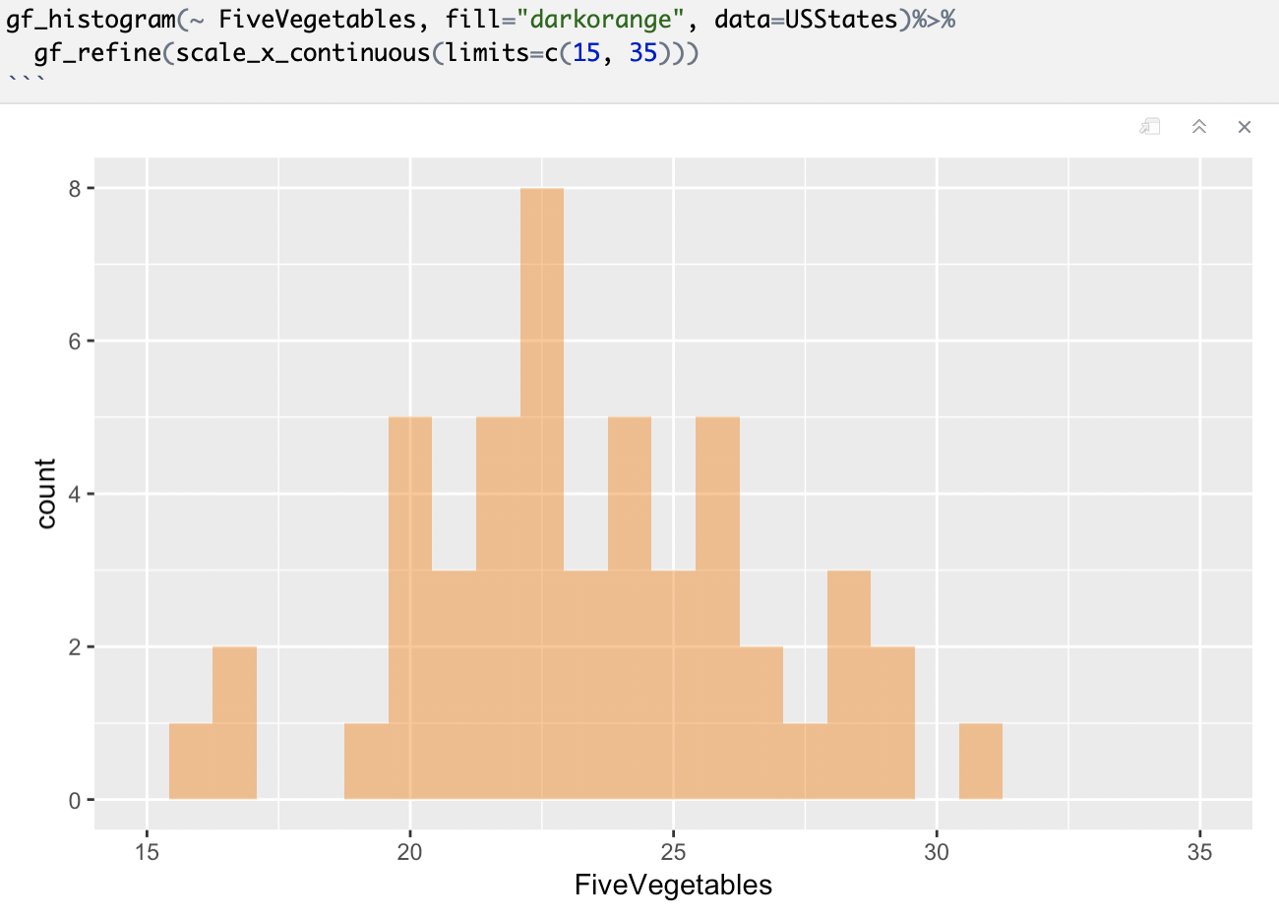
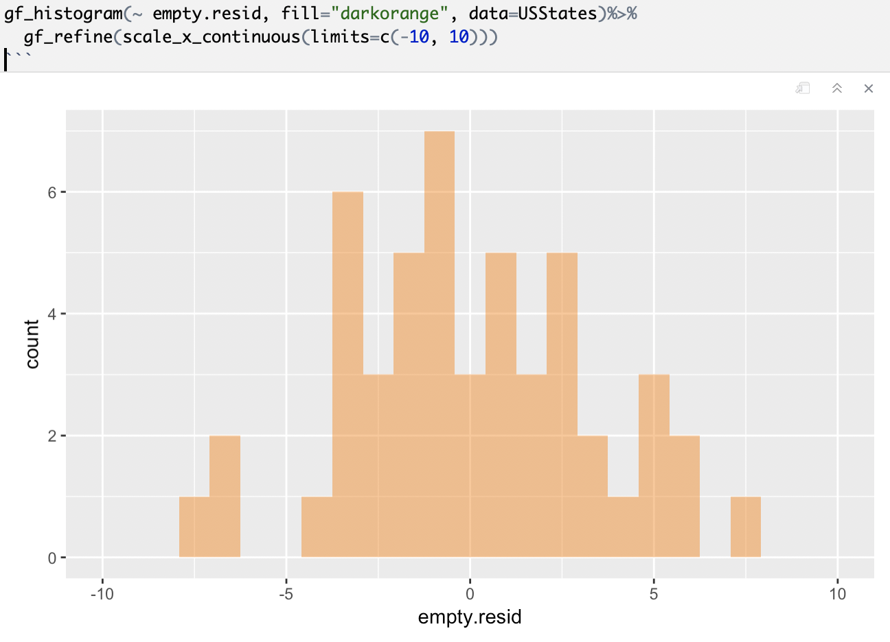
Graphing Residuals
Adjusting scale

Slide 43
Summing Residuals
Use R to sum the residuals for the 50 states from the empty model (empty.resid)
*Think of two different methods for doing this

Slide 44

Summing Residuals
Use R to sum the residuals for the 50 states from the empty model (empty.resid)
*Think of two different methods for doing this
sum(USStates$empty.resid)
sum(resid(lm(FiveVegetables ~ NULL, data=USStates)))
How big is this number? Really big or really little?

Slide 45
DATA = MODEL + ERROR
Confirm that for each state, DATA=MODEL+ERROR.
Make a new variable that is MODEL + ERROR
Subtract it from DATA
Examine the results

Slide 46
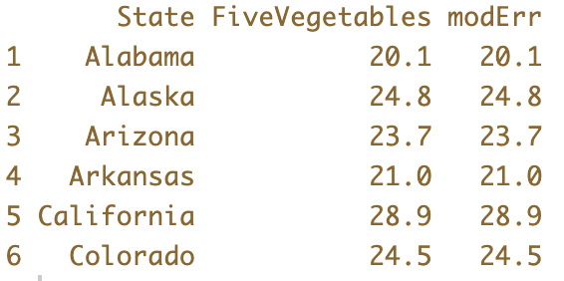
DATA = MODEL + ERROR
USStates$modErr <- USStates$empty.predict + USStates$empty.resid
head(select(USStates, State, FiveVegetables,modErr))

